Slide 1

Computer Engineering Department
A.P. Shah Institute of Technology G.B.Road,Kasarvadavali, Thane(W), Mumbai-400615
UNIVERSITY OF MUMBAI
Academic Year 2020-2021

Slide 2
A Project Report on
PC VOICE ASSISTANT Submitted in partial fulfillment of the degree of
Bachelor of Engineering(Sem-7)
in
Computer Engineering
By
Deepak Yadav(17102054) Jash Vora(17102042) Ronak Jain(17102028) Under the Guidance of
Prof. Jaya Gupta
Notes:
ca

Slide 3
1.Project Conception and Initiation

Slide 4
1.1 Abstract
The project aims to develop a personal-assistant for Computer.
Users can interact with the assistant through voice commands.
It assists the end-user with day-to-day activities like general human conversation, searching queries, reading latest news, translating words, live weather conditions, sending mail through voice.
The software uses a device’s microphone to receive voice requests while the voice output takes place at the speaker.

Slide 5
1.2 Objectives
To Provide User hand-free experience.
To ease the work by providing user voice interface to exceute their query.
Traditional way of searching details online and opening an Application can be given a new touch with the help of Voice Assistant.

Slide 6
1.3 Literature Review
Speech synthesis is the artificial production of human speech. A computer system used for this purpose is called a speech synthesizer, and can be implemented in software or hardware products.
The most important qualities of a speech synthesis system are naturalness and intelligibility.
Naturalness describes how closely the output sounds like human speech, while intelligibility is the ease with which the output is understood.
Some popular speech recognition systems are Siri, Cortana, Google Now, etc.

Slide 7
1.4 Problem Definition
We are all well aware about Cortana, Siri, Google Assistant and many other virtual assistants which are designed to aid the tasks of users in Windows, Android and iOS platforms.
In this virtual assistant systems if user asks web query the system redirects the user to web page and user has to manually search thereafter this can be havoc sometimes, so our Pc Voice Assistant will solve this problem by answering the web query in user interface of our app itself.

Slide 8
1.5 Scope
Presently, Jarvis is being developed as an automation tool and virtual assistant. Among the Various roles played by Jarvis are:
1. Search Engine with voice interactions.
2. Playing Youtube Music/Videos.
3. To-Do application.
4. Shows Results from Wikipedia.
5. Weather Forecasting Application.
6. Translating word or sentence from one language to another language.
7. Wolfram Alpha.

Slide 9
1.6 Technology stack
Front End Framework(User Interface)
Kivy
Kivymd
Main FrameWork
Python

Slide 10
1.7 Benefits for environment & Society
User have a wealth of knowledge at their fingertips and can automate many time consuming activities with just a sentence or two.
Voice assistants can break down barriers for people with disabilities, whether sensory, physical or cognitive. Voice interaction is especially useful for those with visual impairments.
People genuinely enjoy speaking to home assistants, showing that a human-to-machine bond that can be created through voice.

Slide 11
2. Project Design

Slide 12
2.1 Proposed System
The Proposed system aims to simplify basic operations of user, users who might be busy to perform certain operations themselves, elderly people and even users with sight or motor disabilities.
It responds to basic commands like Date and Time, Weather Related Info, Connect Google Send Mail to respective person , Start various services like Hotspot, WiFi, Bluetooth, Music , Youtube and some other services.
The application also possesses speech synthesizing capabilities to give the user the impression that he is actually talking and working with an actual assistant.

Slide 13
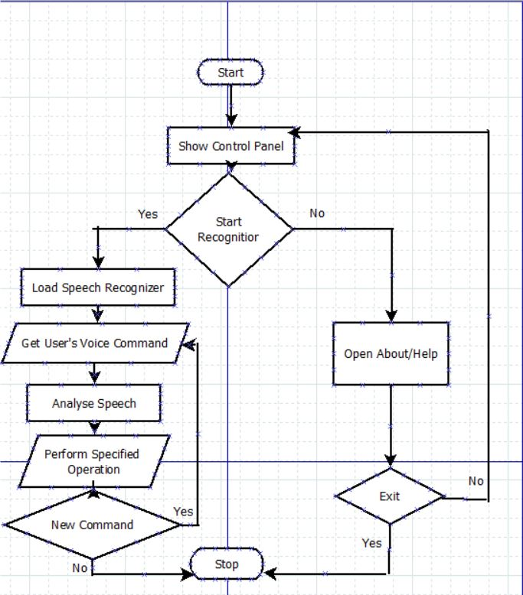
2.2 Design(Flow Of Modules)
Fig 1 : Flowchart of our Project

Slide 14
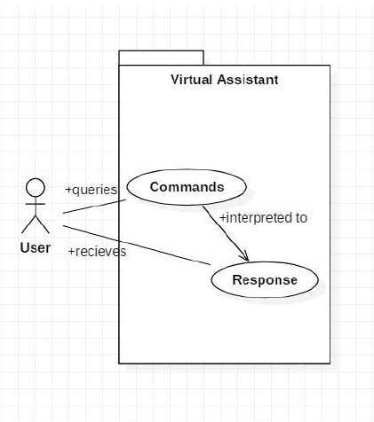
2.3 Description Of Use Case
In this project there is only one user.
The user queries command to the system.
System then interprets it and fetches answer.
The response is sent back to the user.

Slide 15
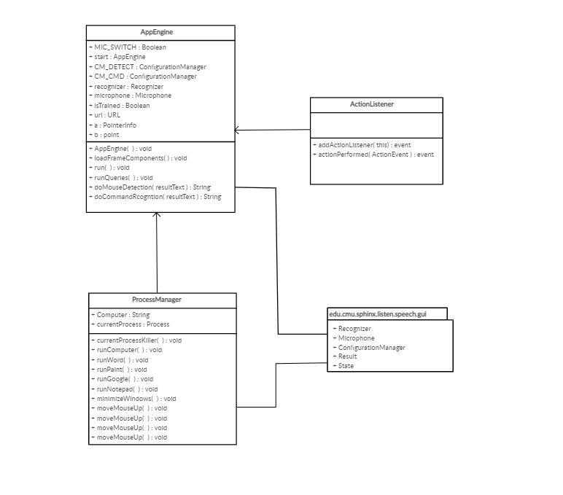
2.4 Class Diagram
Fig 2 : Class Diagram

Slide 16
2.5 Module-1
Speech Recognition
Speech recognition , or speech-to-text, is the ability for a machine or program to identify words spoken aloud and convert them into readable text.
Since we’re building an Application of voice assistant, one of the most important things in this is that your assistant recognizes your voice so for that Speech Recognition module is important

Slide 17
Module-2
Wikipedia Module
Wikipedia is a Python library that makes it easy to access and parse data from Wikipedia.
As we all know Wikipedia is a great source of knowledge ,we have used Wikipedia module to get information from Wikipedia or to perform Wikipedia search.

Slide 18
Module-3
Urllib.parse Module
Urllib.parse defines a standard interface to break Uniform Resource Locator (URL) strings up in components (addressing scheme, network location, path, parameters, query and fragment), to combine the components back into a URL.
We have used urllib.parse to retrive information from Wolfram alpha API and to get user query based youtube url.

Slide 19
Module-4
re(Regular Expression) Module
A regular expression may be a sequence of characters that helps us in searching a pattern in string.
Each character during a regular expression is either a metacharacter, having a special meaning, or a daily character that features a literal meaning.

Slide 20
3.Implementation

Slide 21
3.1 Proposed System
The Proposed system aims to simplify basic operations of user, users who might be busy to perform certain operations themselves, elderly people and even users with sight or motor disabilities.
It responds to basic commands like Date and Time, Weather Related Info, Connect Google Send Mail to respective person , Start various services like Hotspot, WiFi, Bluetooth, Music , Youtube and some other services.
The application also possesses speech synthesizing capabilities to give the user the impression that he is actually talking and working with an actual assistant.

Slide 22
3.1.1 Algorithms
Speech Recognition Algorithm:
A speech recognition algorithm or voice recognition algorithm is used in speech recognition technology to convert voice to text.
Text-To-Speech Algorithm:
A text-to-speech (TTS) system converts normal language text into speech; other systems render symbolic linguistic representations like phonetic transcriptions into speech.

Slide 23
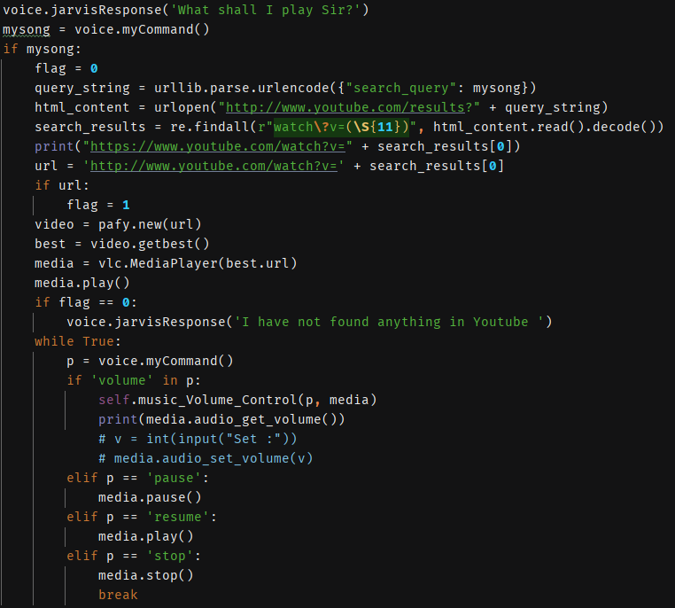
3.1.2 Pseudo Code

Slide 24
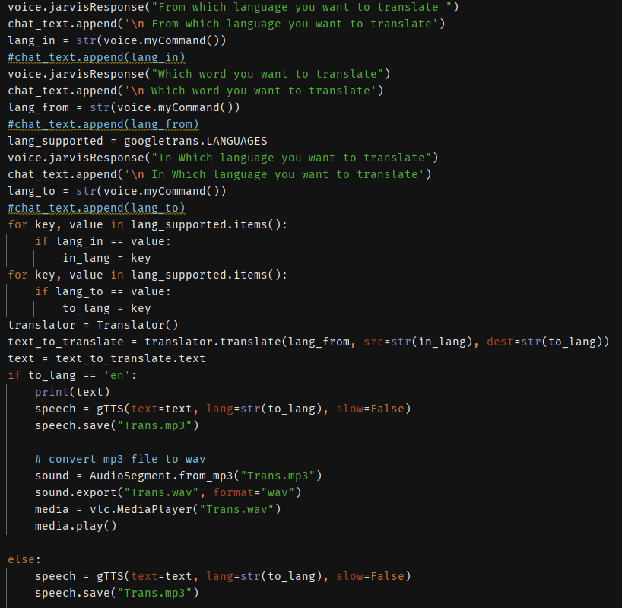

Slide 25
3.1.3 Platforms for Execution
Pycharm
Anaconda

Slide 26
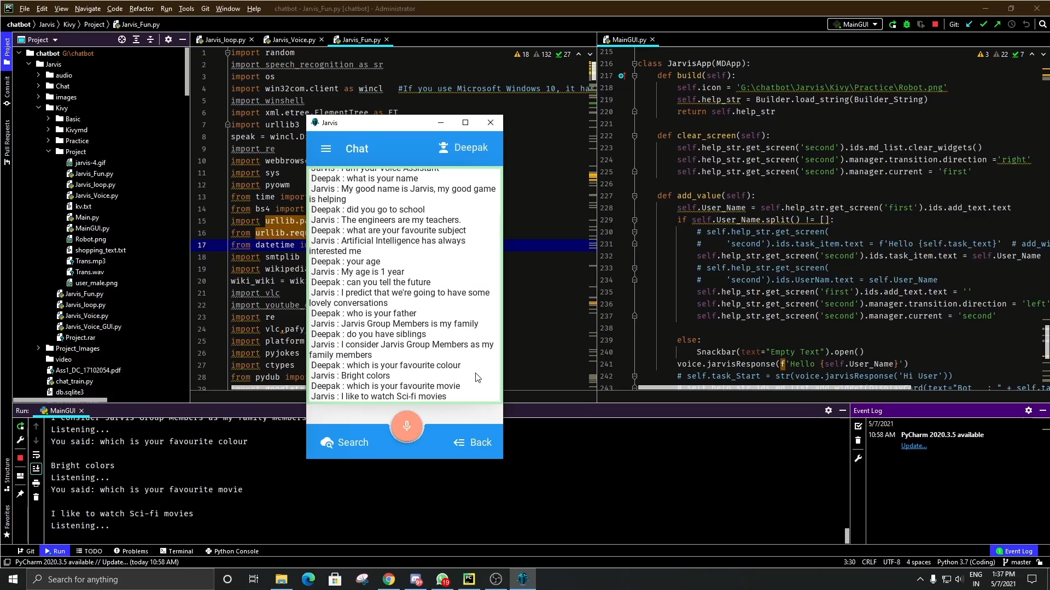
4. Results

Slide 27
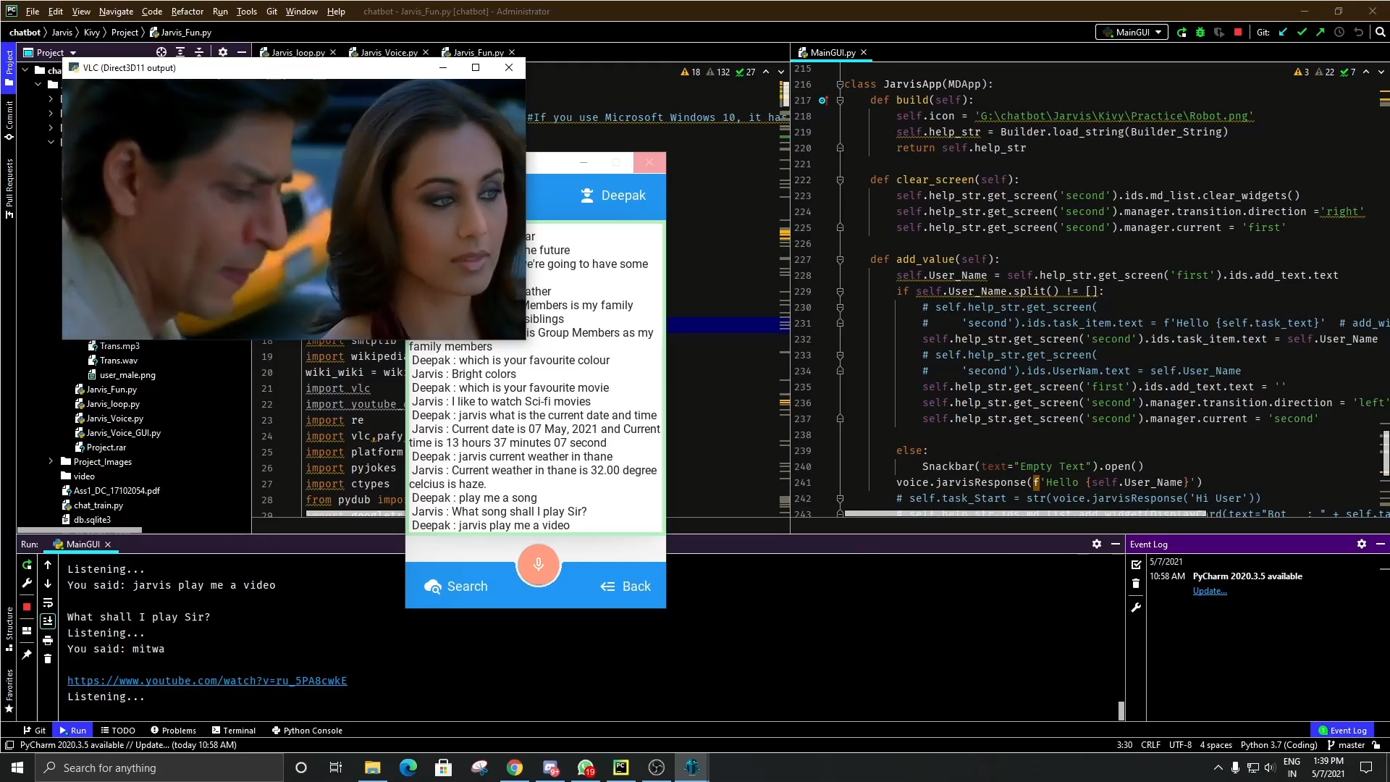

Slide 28
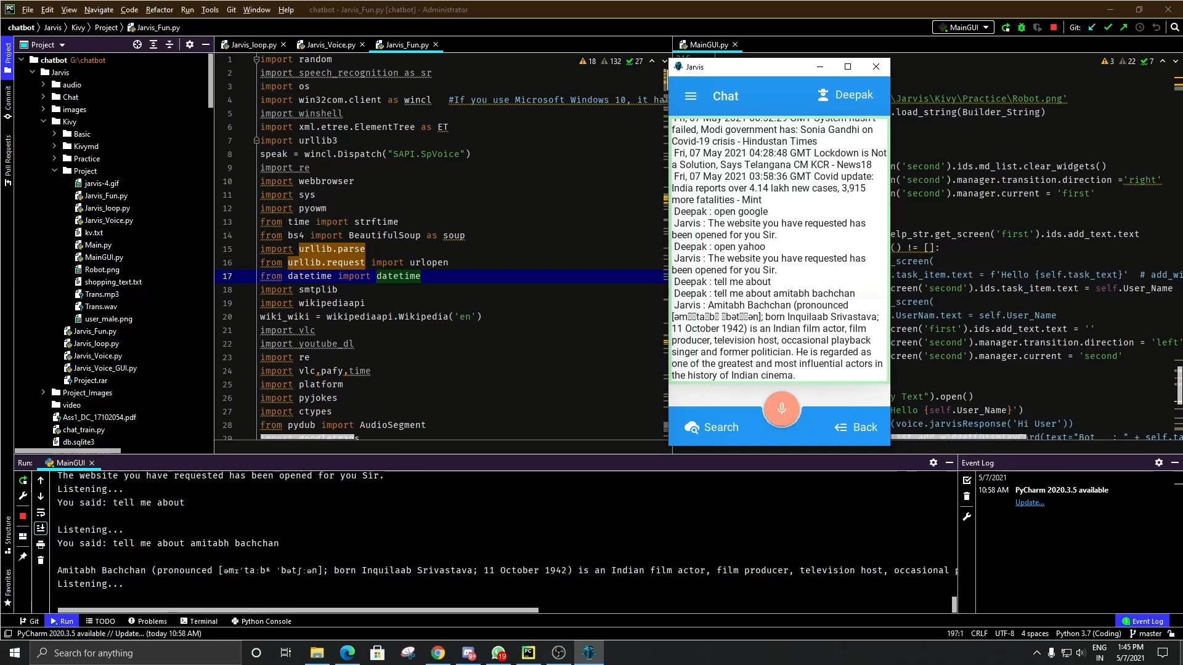

Slide 29


Slide 30
5.Conclusion
Through this voice assistant, we have automated various services using a single line command.
It eases most of the tasks of the user like searching the web, retrieving weather forecast details, translating word from one language to another language, accessing youtube videos, sending mail through voice and solving computational queries.
We aim to make this project a complete User Interface based project and give user all its query on the very same User Interface.

Slide 31
6. References
V. Mitra, H. Franco, M. Graciarena and D. Vergyri, "Medium-duration modulation cepstral feature for robust speech recognition," 2014 IEEE International Conference on Acoustics, Speech and Signal Processing (ICASSP), Florence, Italy, 2014, pp. 1749-1753, doi: 10.1109/ICASSP.2014.6853898.
Jin He, Rui Yu, Xinsheng Wang and Lina Huang, "Validation of query expression based on Regular Expression," 2011 International Conference on Computer Science and Service System (CSSS), Nanjing, China, 2011, pp. 1879-1882, doi: 10.1109/CSSS.2011.5974145.

Slide 32
7.Bibliography
Computational Speech Processing: Speech Analysis, Recognition, Understanding, Compression, Transmission, Coding, Synthesis ; Text to Speech Systems, Speech to Tactile Displays, Speaker Identification, Prosody Processing : BIBLIOGRAPHY, by Conrad F. Sabourin, 1994, 2 volumes, 1187p, ISBN 2-921173-21-2, INFOLINGUA inc., P.O. Box 187 Snowdon, Montreal, H3X 3T4, Canada. See also: http://gomer.mlink.net/infolingua.html

Slide 33
Thank You

